Slide 1

PIZZA Sales Data Analysis using SQL

Slide 2

Queries in
SQL for data analysis of pizza sales

Slide 3
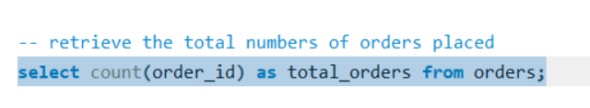

Retrieve the total numbers of orders placed

Slide 4
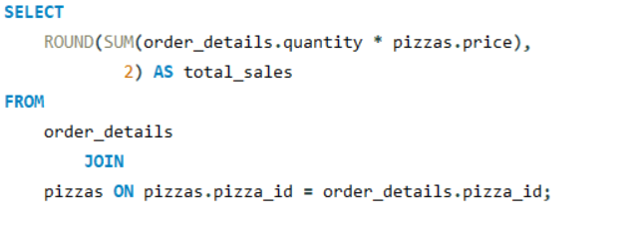
Calculate the total revenue from pizza sales

Slide 5
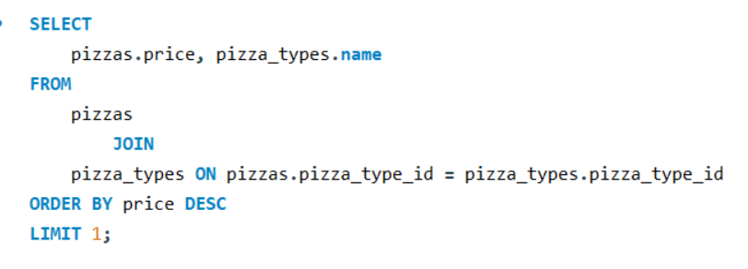
Identify the highest priced pizza

Slide 6
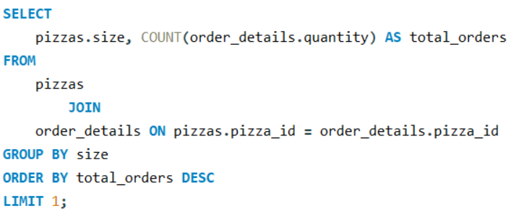
Identify the most common size pizza ordered

Slide 7
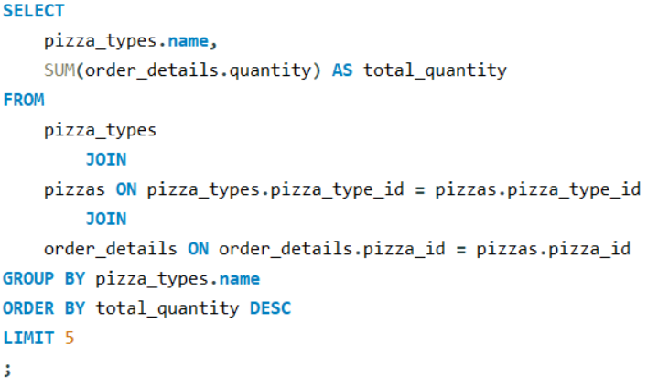
List the top 5 most ordered pizza types along with their quantities

Slide 8
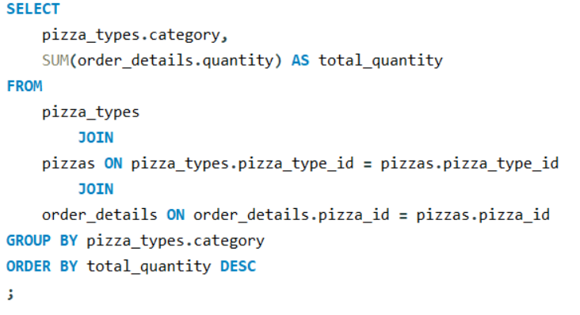
Join the necessary tables to find the total quantity of each pizza category ordered

Slide 9
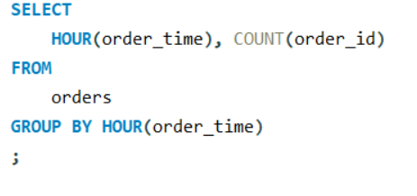
Determine the distribution of orders by hour of the day

Slide 10
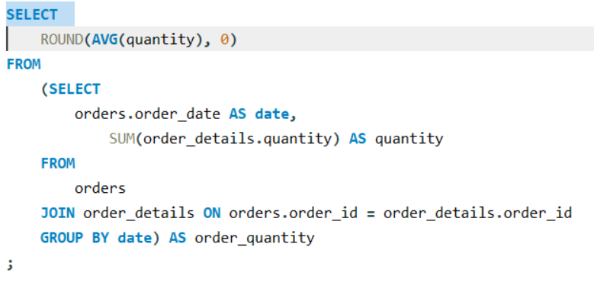
Join relevant tables to find the category wise distribution of pizzas

Slide 11
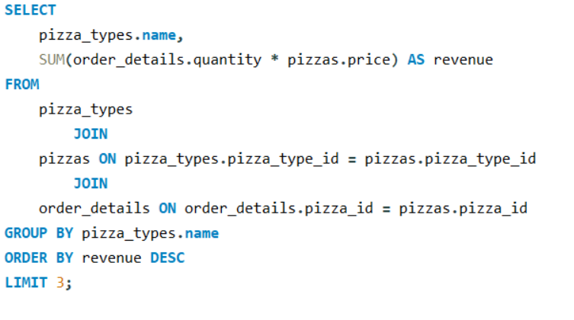
Group the orders by date and calculate the average number of pizzas ordered per day

Slide 12
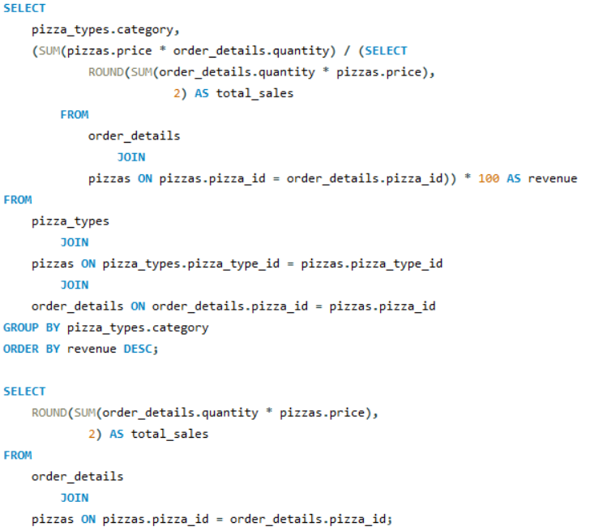
Group the orders by date and calculate the average number of pizzas ordered per day

Slide 13
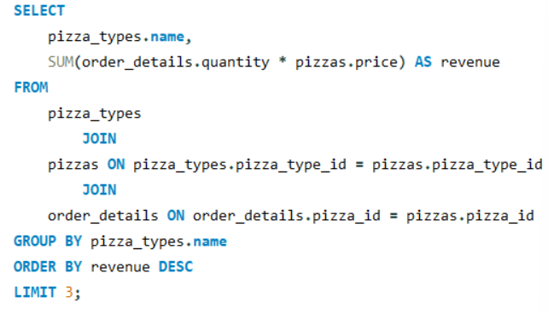
Determine the most ordered pizzas types based on revenue

Slide 14
Calculate the percentage contrubution of each pizza type to total revenue

Slide 15
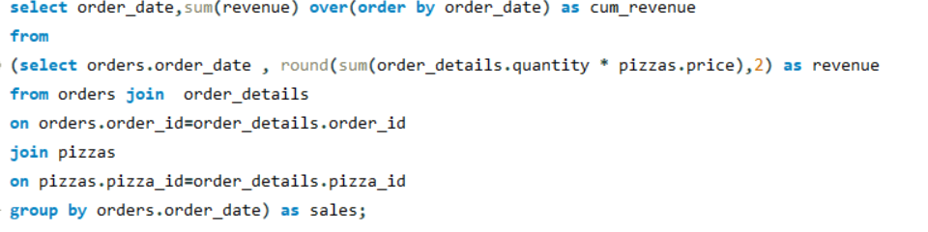
Analyse the cumulative revenue generated over time

Slide 16
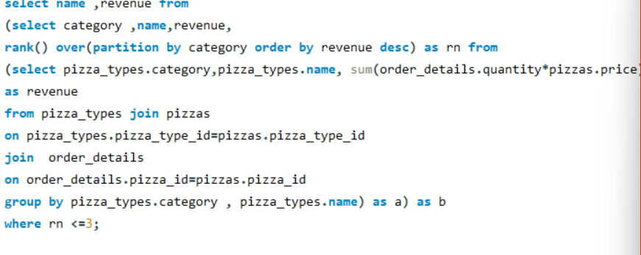
Determine the top 3 most ordered pizza types based on revenue for each pizza category

Slide 17
THANK YOU

